Slide 1


FAKE NEWS DETECTION USING MACHINE LEARNING
20ADT44 – Applied Machine Learning
RISHI RAGHAV G - 21ADR038
ROHITH .S. J - 21ADR040
VIBEESH N - 21ADR059
VIGNESH T - 21ADR060
VIJAYAKUMARAN S – 21ADR061
Team mentor:
Ms. D. Sathya

Slide 2
Introduction
The definition of fake news is the information that pushes people to the wrong road.
Fake news is spreading like a wildfire these days, and people are sharing it without confirming it.
Fake news can be intimidating as they attract more audience than normal.People use them because this can be a very good marketing strategy.

Slide 3
PROBLEM STATEMENT
Now a days it is extremely difficult to decide whether the news we come across is real or not.
This fake news had left an indelible mark on people and culture.
Fake news play a major in election time.
So to find whether the given information or news true or false using machine learning algorithm.

Slide 4
OBJECTIVE
The objective of this project is to examine the problems and reduce the spread of fake news.
The fake news is a problem that is heavily affecting society and our perception of not only the media but also facts and opinions themselves.
By using the artificial intelligence and the machine learning, the problem can be solved.
So,our focus is to find which machine learning algorithm is best suitable for text dataset by comparing the performance.

Slide 5
LITERATURE SURVEY
S.NO | PAPER NAME | ALGORITHM USED | METRICS USED | PERFORMANCE
1 | Fake News Detection Using Machine Learning Ensemble Methods | Logistic regression, Svm, Random forest classifiers. | F1-score Accuracy Precision Recall | Accuracy - 91.3%
2 | FAKE NEWS DETECTION USING MACHINE LEARNING | Naive Bayes, Support Vector Machine- SVM, Logistic Regression. | Accuracy | Accuracy - 91.8%

Slide 6
3. | Detecting Fake News using Machine Learning | Recurrent Neural Network, Logistic Regression, Random Forests | Accuracy | Accuracy - 93.1%
4. | Predicting Fake News using NLP and Machine learning | Random Forest, AdaBoost classifier, Logistic Regression. | Accuracy | Accuracy - 92.3%
5. | Fake News Detection Using Machine Learning | Multinomial NB ,Passive Aggressive | Accuracy | Accuracy - 87.3%

Slide 7
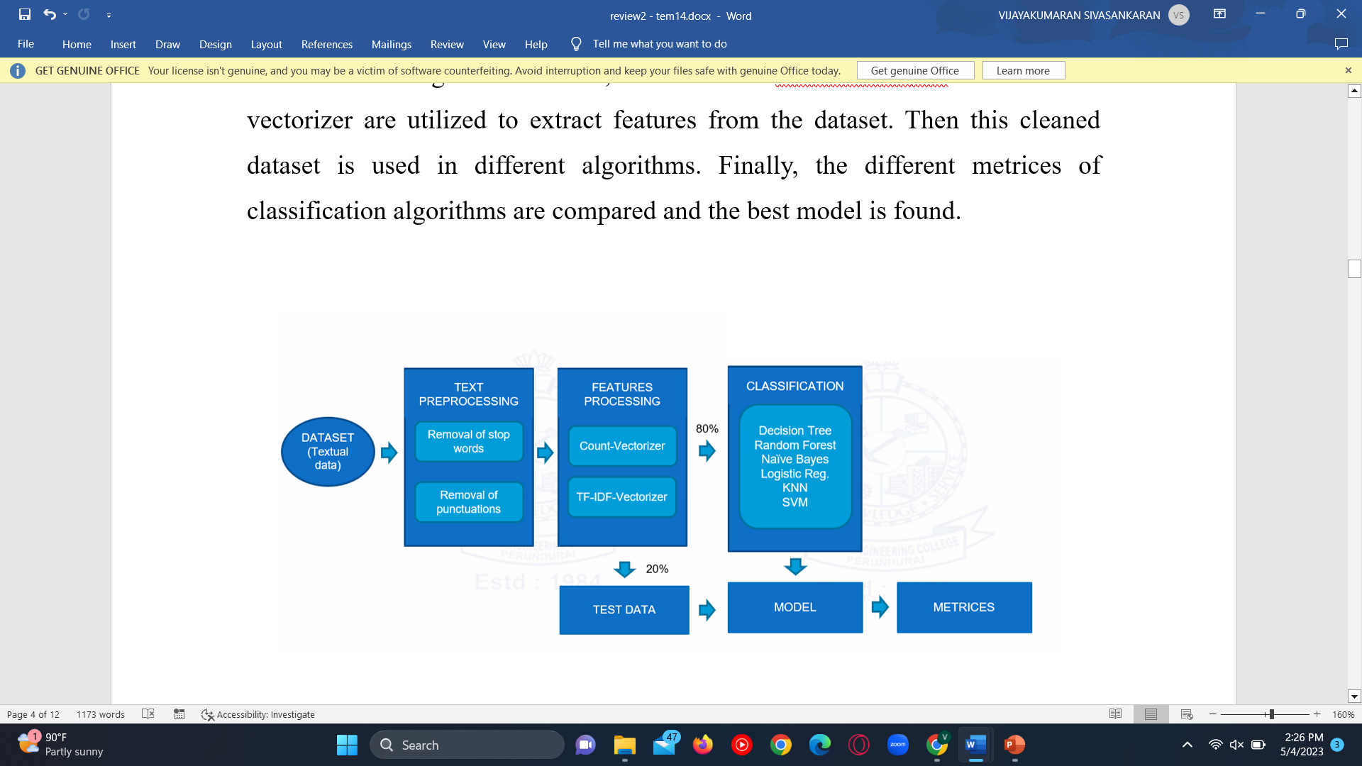
PROPOSED SYSTEM

Slide 8
FEATURE EXTRACTION
Text classification:
we are using TF-ID ( Term Frequency & Inverse Document Frequency ) is a powerful feature engineering technique used to identify the important words or more precisely rare words in the text data.

Slide 9
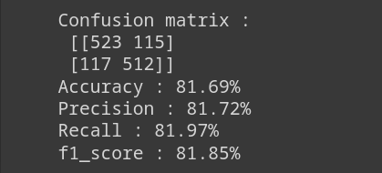
ALGORITHMS
Decision Tree classifier:
A decision tree is a supervised machine learning algorithm, which is utilized for both classification and regression tasks.It has a hierarchical, tree structure, which consists of a root node, branches, internal nodes and leaf nodes.

Slide 10
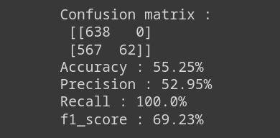
k-nearest Neighbors:
The k-nearest neighbors algorithm, also known as KNN , is a supervised machine learning classifier, which used to make classifications or predictions.

Slide 11
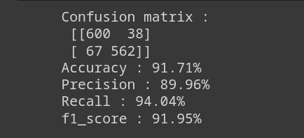
Logistic regression:
It is a supervised machine learning method.Logistic regression is used to calculate or predict the probability of a binary (yes/no) event occurring.

Slide 12
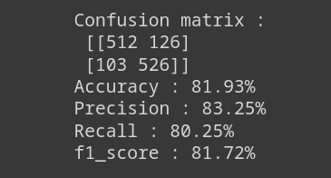
Naïve Bayes classifier:
The Naïve Bayes classifier is a supervised machine learning algorithm, which is used for classification tasks, like text classification.

Slide 13
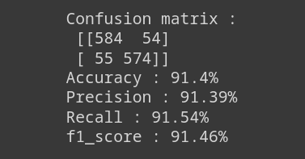
Random Forest:
Random Forest Algorithm is a supervised machine learning algorithm is used for Classification and Regression problems in Machine Learning.

Slide 14
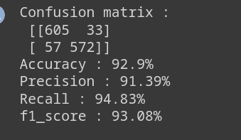
Support Vector Machine:
SVM is a supervised machine learning algorithm that works best on smaller datasets . Support Vector Machine, can be used for both regression and classification .But is best for classification.

Slide 15
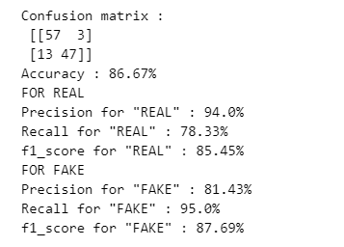
Gradient Boosting Classifier:
Gradient Boosting is a functional gradient algorithm that repeatedly selects a function that leads in the direction of a weak hypothesis or negative gradient so that it can minimize a loss function. Gradient boosting classifier combines several weak learning models to produce a powerful predicting model.

Slide 16
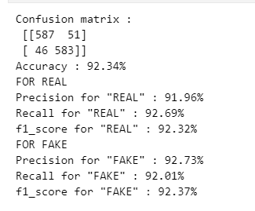
XGBoost Classifier:
XGBoost classifier is a Machine learning algorithm that is applied for structured and tabular data. XGBoost is an implementation of gradient boosted decision trees designed for speed and performance.

Slide 17
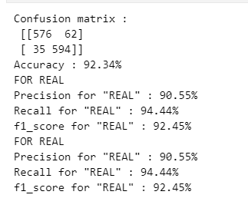
AdaBoost Classifier:
AdaBoost algorithm, short for Adaptive Boosting, is a Boosting technique used as an Ensemble Method in Machine Learning. It is called Adaptive Boosting as the weights are re-assigned to each instance, with higher weights assigned to incorrectly classified instances.

Slide 18
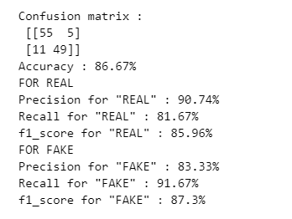
Voting Classifier:
Voting Classifier is a machine-learning algorithm often used by Kagglers to boost the performance of their model and climb up the rank ladder. Voting Classifier can also be used for real-world datasets to improve performance, but it comes with some limitations.

Slide 19
CONCLUSION
Thus by analysing the several algorithms we can conclude that Support Vector Machine has the highest accuracy of 94.32% so we are selecting the SVM as our base model. Using this model we can predict the fake news with higher accuracy.

Slide 20
REFERENCE
https://towardsdatascience.com/predicting-fake-news-using-nlp-and-machine-learning-scikit-learn-glove-keras-lstm-7bbd557c3443
https://sist.sathyabama.ac.in/sist_naac/documents/1.3.4/b.e-cse-batchno-214.pdf
https://www.hindawi.com/journals/complexity/2020/8885861/
D. Keskar, S. Palwe, and A. Gupta, Fake News Classification on Twitter Using Flume, N-Gram Analysis, and Decision Tree Machine Learning Technique. Singapore: Springer, 2020, pp. 139–147, doi: 10.1007/978-981-15-0790-8_15.
A. Bali, M. Fernandes, S. Choubey, and M. Goel, ‘‘Comparative performance of machine learning algorithms for fake news detection,’’ 2019, doi: 10.1007/978-981-13-9942-8_40.
K. Shu, D. Mahudeswaran, S. Wang, D. Lee, and H. Liu, ‘‘FakeNewsNet: A data repository with news content, social context, and spatiotemporal information for studying fake news on social media,’’ Big Data, vol. 8, no. 3, pp. 171–188, Jun. 2020, doi: 10.1089/big.2020.0062.

